Slide 1






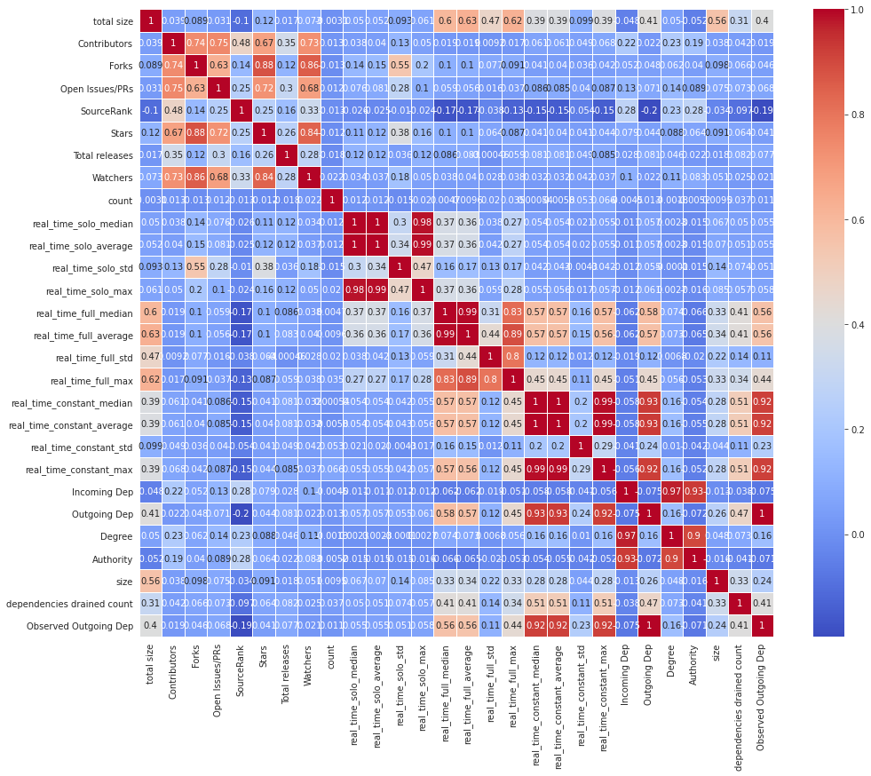
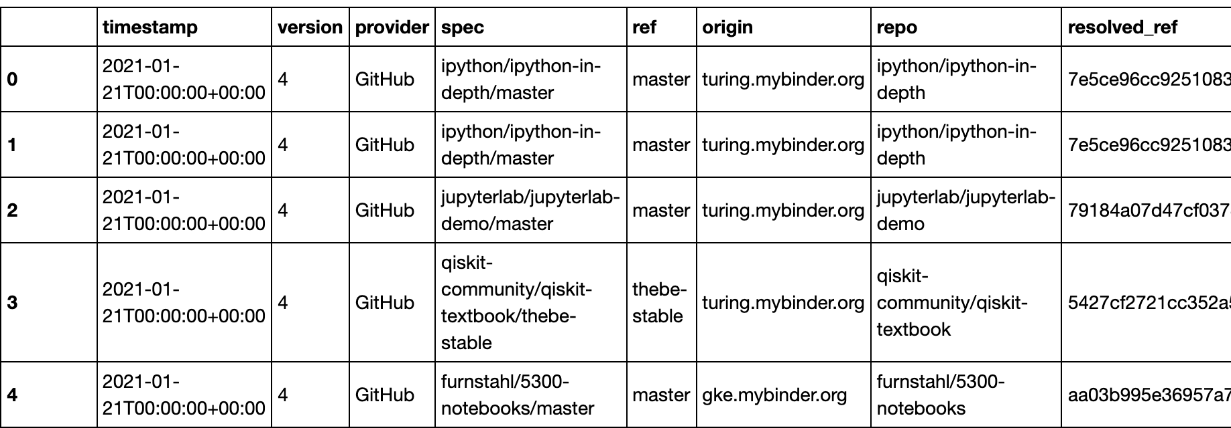
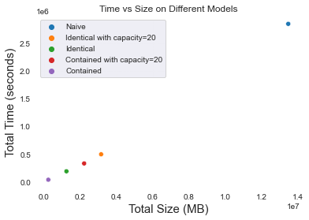
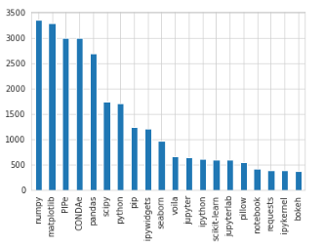

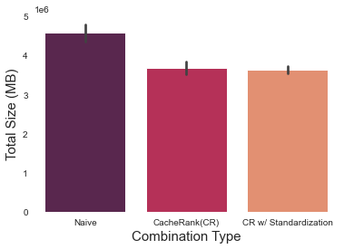
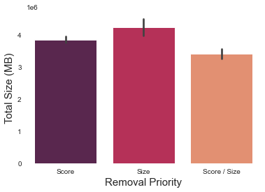
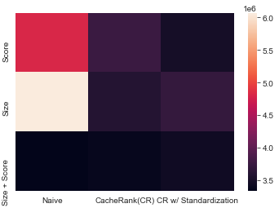
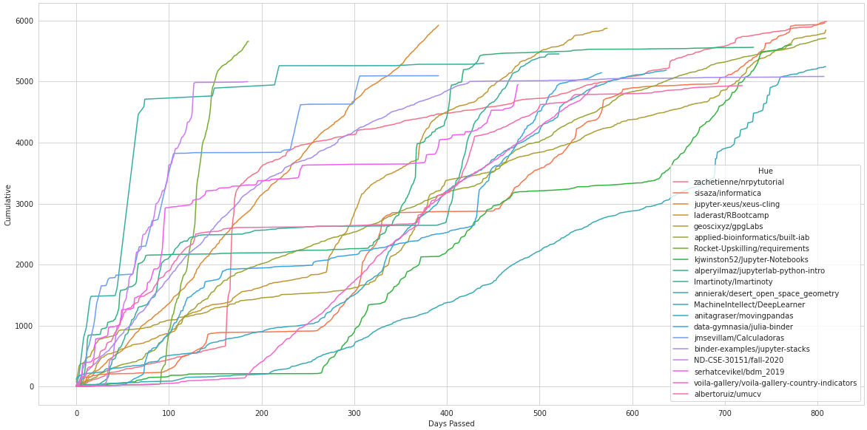
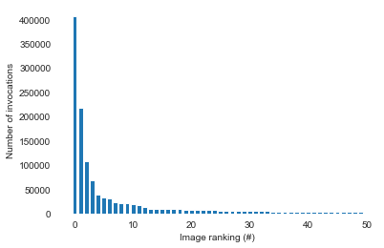
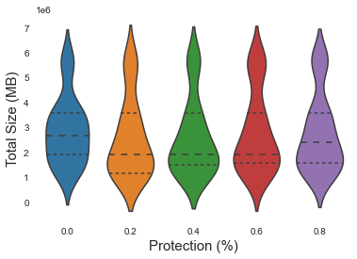
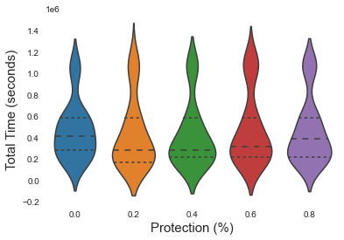
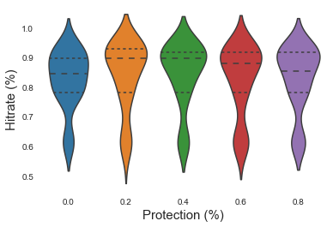
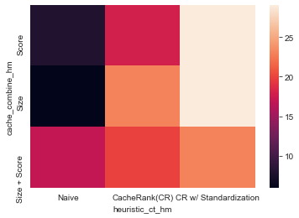
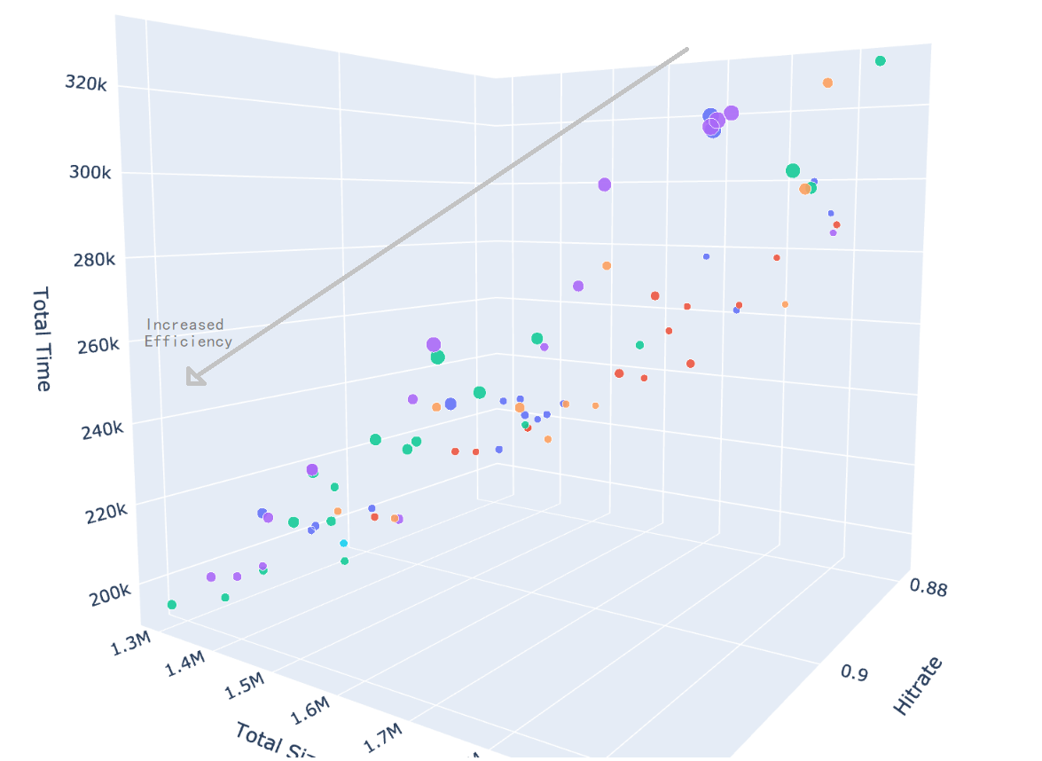
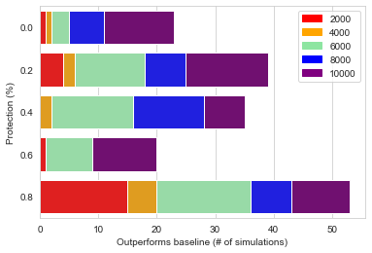
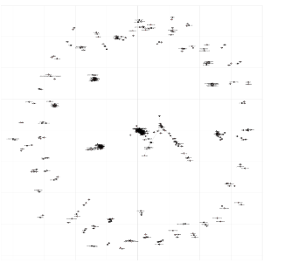
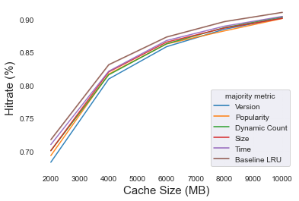
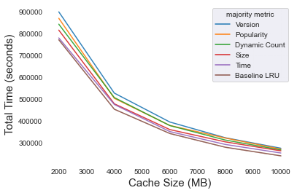
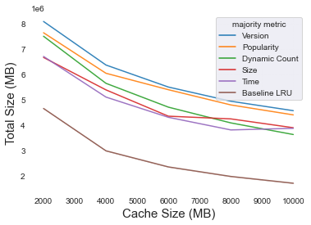
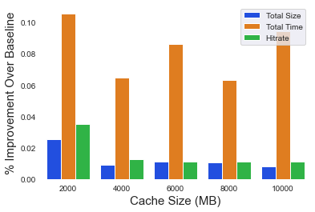
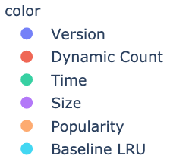
Regulating Traffic in a Crowded Cache:
Overcoming the Container Explosion Problem
Kevin Gao, Tim Shaffer (Advisor), Kyle Chard (Advisor)
University of California, Berkeley, University of Notre Dame, University of Chicago
Abstract
Methodology
Container Sharing
Naive container management in multi-user online services leads to slow response times and enormous container caches
We consider container caching methods for multi-user services providing interactive Python environments. We explore various metrics, including package size, installation time, version history and popularity
We design a simulator that evaluates custom heuristics and compares their performance to an LRU Cache implementation
We explore performance (time, size, hitrate) with various caching strategies using production workloads from Binder
Simulator
Loops through each binder launch temporally
Considers:
Version mismatch
Constraints
Assigns a score to each container based on combination of metric values
Implements container sharing and a lowest score caching policy
Python Virtual Environment: bash scripting to collect package stats
Data Cleaning, Augmentation, Integration
Baseline: No containers are shared. Requests must use a unique container for each repository.
Identical: Repositories with the same requirements may share containers.
Contained: Repositories that are fully contained by a container in the cache are shared.
Binder Launches / Image Recipes
MODEL
Share container?
Yes
Evaluate Outputs
Iterate launch dataset
Image recipe
No
/
CACHE
Capacity: 5
M = Metric
Version Compatibility
Score ➡ | M1 | M2 | M3 | M4 | Total
Container 1
Container 2
Container 3
Container 4
Container 5
For each container there is a possibility that it is incompatible when package versions are miss-matched. While this reduces opportunities for sharing, it is more realistic when considering reproducibility.
Constraints
Output Variables
Metric Weights
Exploratory Data Analysis
Web Scraper: crawled PYPI & libraries.io for popularity and version stats
Random Number Generator
Eviction
Binder
Heuristic Evaluation
Weighted Combination
MRU Cache Protection
Binder is an online service that allows users to execute Git repositories and run interactive notebooks
Binder dynamically creates a container for each launch based on the dependencies specified in the repository
Version: average(version count) / min(scraped date - timestamp of first version). Prioritizes higher time between versions.
Popularity: average(stars / median(stars) + forks / median(forks)). A combination of popularity (GitHub) statistics.
Size: sum(size). Total package size on disk.
Time: sum(time). Total time to install package.
Dynamic Count: average(dynamic freq) / (# of launches). A dynamic count of package invocations within a sliding window.
First x containers in LRU are “protected” from eviction
Mixed strategy to prioritize most recently used items at the front of the cache and apply metrics to sort the back of the cache
A “holistic” score assigned to a container:
Let M = iteration over each metric
m_coeff = weighting for metric
Naïve: sum(m_coeff * M / median(M))
CacheRank (CR): sum(m_coeff * Rank(M))
CR w/ standardization: sum(m_coeff * (Rank(M) – mean(Rank(M)) / std(Rank(M))
Prioritizing the removal of containers from the unprotected part of the cache:
Score: min(“holistic” score)
Size: Minimum Knapsack algorithm to greedily maintain the largest cache size possible
Score + Size: min(“holistic” score / container size).
Extremely small containers will have a large score and be hard to remove.
The average total size consumption of each simulation at an intersection between score and removal priority methods. The naive holistic score is expected to be weakest, but achieves admirable efficiency when paired with the combination method in removal priority.
We used every 20% as the percentage to protect in the cache. We see that this strategy provides useful insight as the strongest average results tend to come from protection values in the middle, [0.4, 0.6, 0.8].
An initial high riser: launch invocations over time for 20 repositories over a 600 day period. Most repos tend to show a large spike of usage at the beginning while a few have a balanced distribution of calls throughout its lifetime.
Frequency of launches for each unique container image. We see a long tail distribution where few containers are launched many times, while most containers are launched infrequently.
Our Dataset
Number of containers that outperform the base LRU model at every protection level, where color represents the cache size constraint. While the highest protection value is strongest at low cache size limits, the middling values get stronger as the cache limit increases.
Our Dataset
We filtered the Binder launch dataset to only Python repositories
14 million launch records
4575 unique Python libraries
33,987 unique repositories
17,019 unique images
For each repository we obtained the Python dependencies and computed
Install time and size
GitHub statistics (stars, forks)
Version lifetime (how long between versions)
Number of containers that beat the base LRU model at a cache constraint level. Interestingly, there is no strategy in either scenario that is a clear winner.
References
[1] Binder, https://mybinder.org, 2021
[2] T. Shaffer, K. Chard, D. Thain, ”An Empirical Study of Package Dependencies and Lifetimes in Binder Python Containers”. eScience, 2021.
[3] T. Shaffer et al., “Solving the Container Explosion Problem for Distributed High Throughput Computing,” IPDPS, 2020
A 5D plot showing the hitrate (x), total size consumption (y), and total installation time (z).
The cache size is represented by the size of a circle and the most dominant metric type (largest absolute value) is the color of the plotted point
Percentage improvements for total size, time, and hitrate shown between the most optimal set of parameters and base LRU model. The greatest improvement is shown in the total installation time, with a >6% improvement at every tested level of the cache size constraint.
Acknowledgements
Clustering of Python packages based on cosine similarity. We see visible “islands” of commonly related packages.
A comparison across different metrics and how they perform against LRUCache (None) individually. Without a combination of multiple heuristic types, any single heuristic performs poorly on average against the baseline LRU model. This difference is reflected greatest in the total container storage usage, as the baseline beats any metric by roughly 150-250% depending on cache size.
This work is supported in part by the National Science Foundation grant NSF- 1461260 (BigDataX REU) and NSF-2004894 (funcX)

